Slide 1
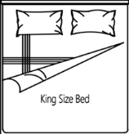
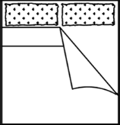
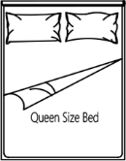
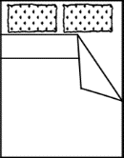
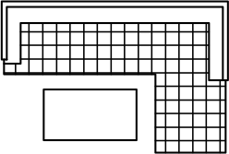
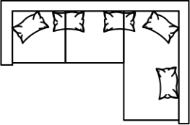
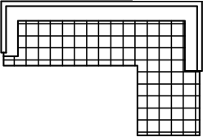
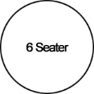
D&A Work Design Pte Ltd
100 Peck Seah Street #08-14 PS100
S079333 ROC No: 201134767C
Whatsapp: Derick Beh 90013330
dnaworkdesign.com
Furniture Templates

Slide 2
D&A Work Design Pte Ltd
100 Peck Seah Street #08-14 PS100
S079333 ROC No: 201134767C
Whatsapp: Derick Beh 90013330
Furniture layout plan

